Slide 1
Evaluation Metrics
Lecture 7
ENG : Shereen saad

Slide 2
Regression

Slide 3
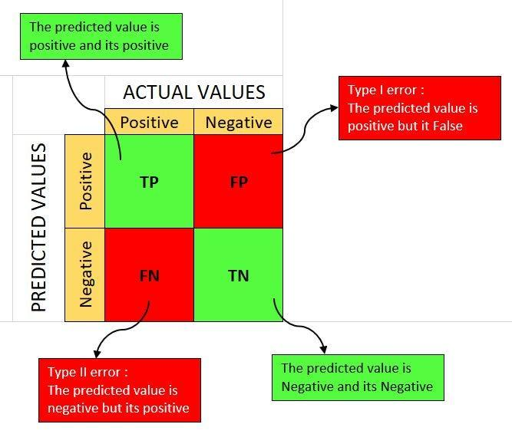
Confusion matrix

Slide 4
Confusion matrix
A confusion matrix is a table used to evaluate the performance of a classification model. It provides insights into the model’s accuracy by comparing predicted labels with actual labels. The matrix consists of four key components:
True Positive (TP): The model correctly predicts a positive class.
True Negative (TN): The model correctly predicts a negative class.
False Positive (FP): The model incorrectly predicts a positive class (Type I Error).
False Negative (FN): The model incorrectly predicts a negative class (Type II Error).

Slide 5
Importance of the Confusion Matrix
Provides a comprehensive evaluation of classification performance.
Helps identify misclassifications and the type of errors the model makes.
Allows for the calculation of important metrics such as accuracy, precision, recall, and F1-score.
Useful in imbalanced datasets where accuracy alone is misleading.

Slide 6
When to Use a Confusion Matrix?
When evaluating classification models such as logistic regression, decision trees, or neural networks.
When dealing with imbalanced datasets to understand model bias towards certain classes.
When fine-tuning model parameters to improve classification performance.
When explaining the effectiveness of a model in real-world applications such as medical diagnosis or fraud detection.

Slide 7
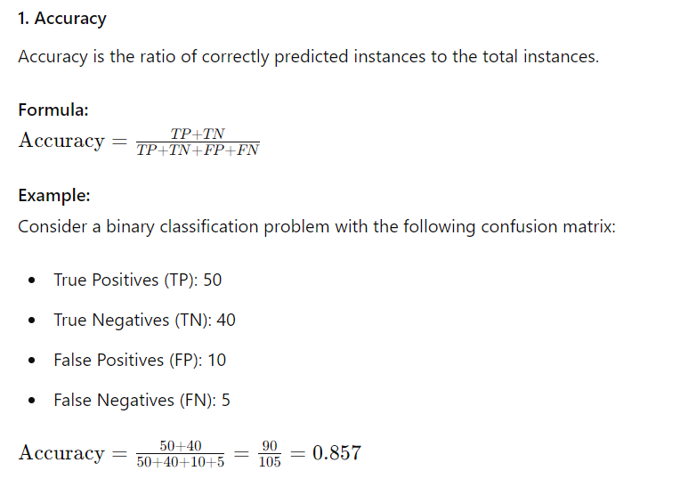

Slide 8
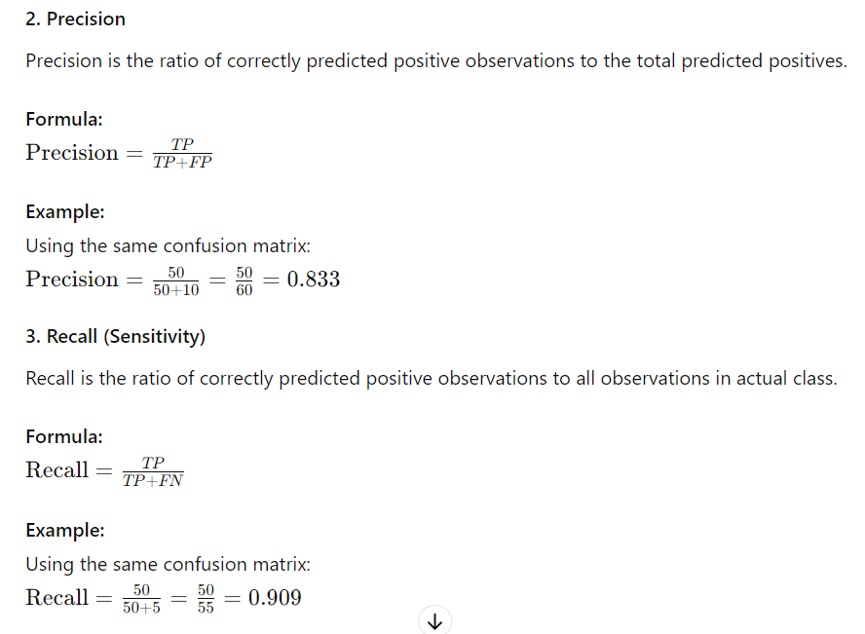

Slide 9
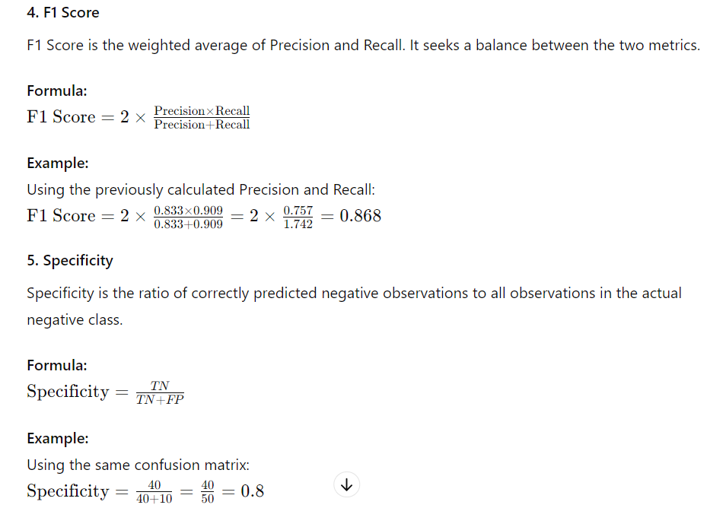

Slide 10
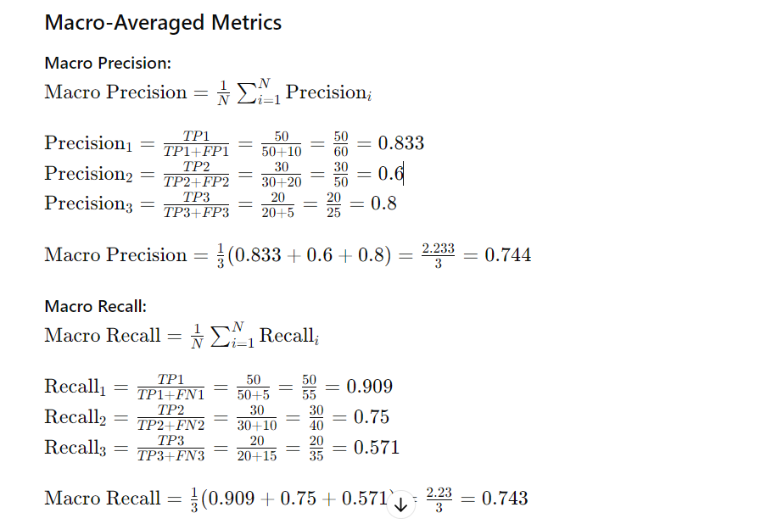
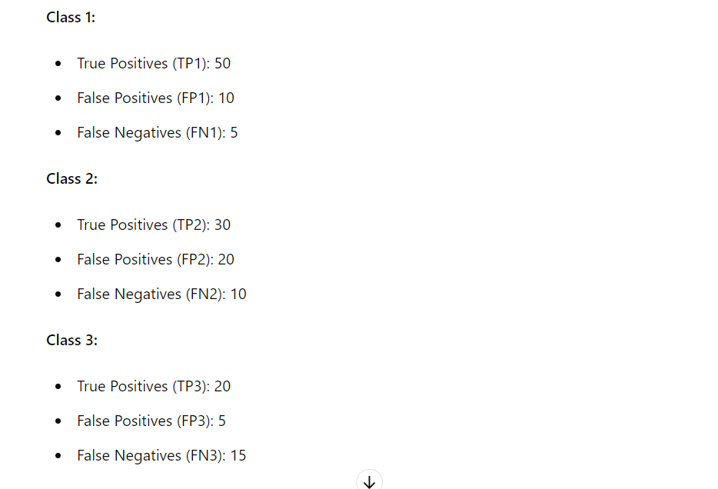
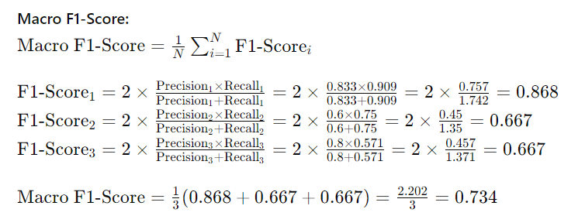
Macro, micro and weighted metrics

Slide 11
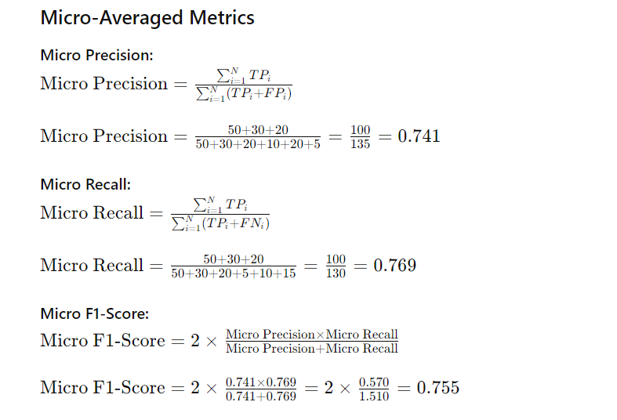
Macro, micro and weighted metrics

Slide 12
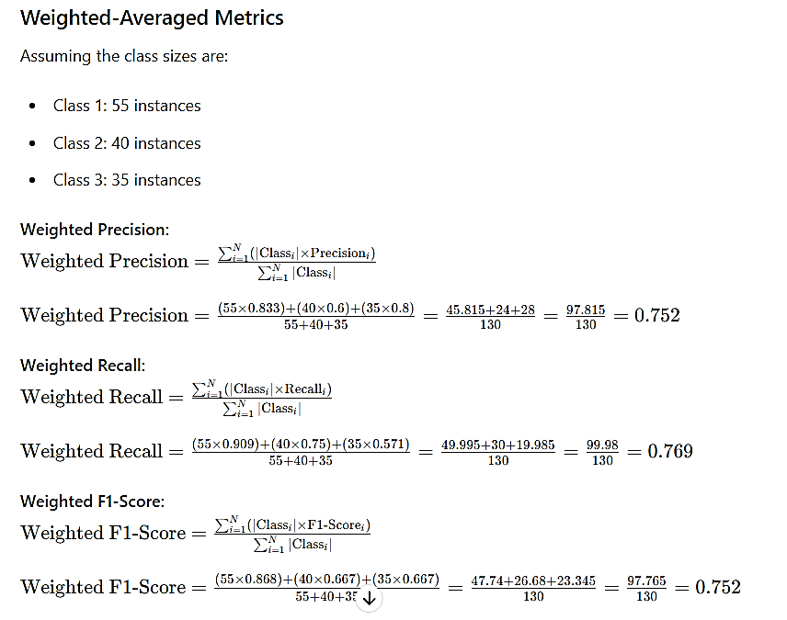
Macro, micro and weighted metrics

Slide 13

Naive Bayes

Slide 14
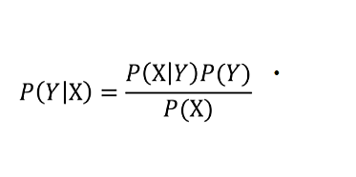
Bayes’ Theorem

Slide 15
Importance of Naive Bayes
Efficient for large datasets.
Works well with high-dimensional data.
Requires less training data compared to other classifiers.
Can handle both continuous and categorical data.
Used in real-world applications such as spam filtering, sentiment analysis, and medical diagnosis.

Slide 16
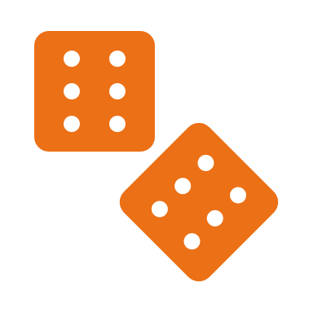
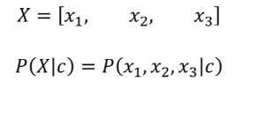
Naive Bayes
For multiple features:

Slide 17
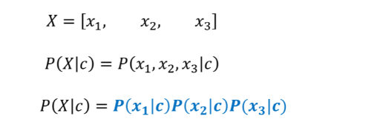
Naive Bayes
Our classifier is Naïve, it assumes all features are independent

Slide 18
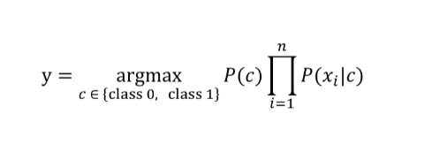
Naive Bayes
In general, for n features:

Slide 19
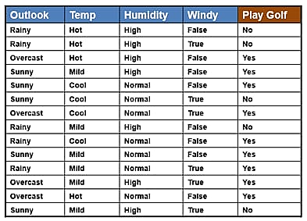
Example

Slide 20
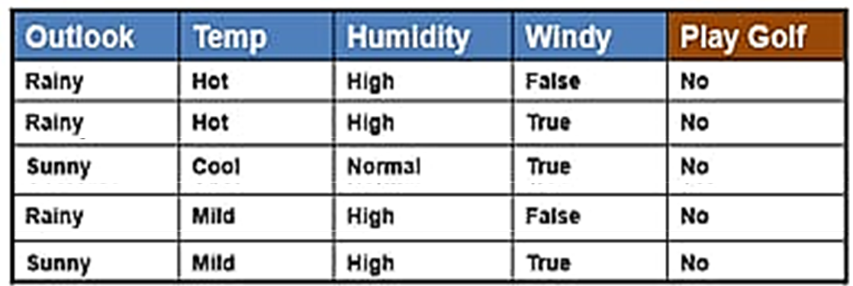
NO

Slide 21
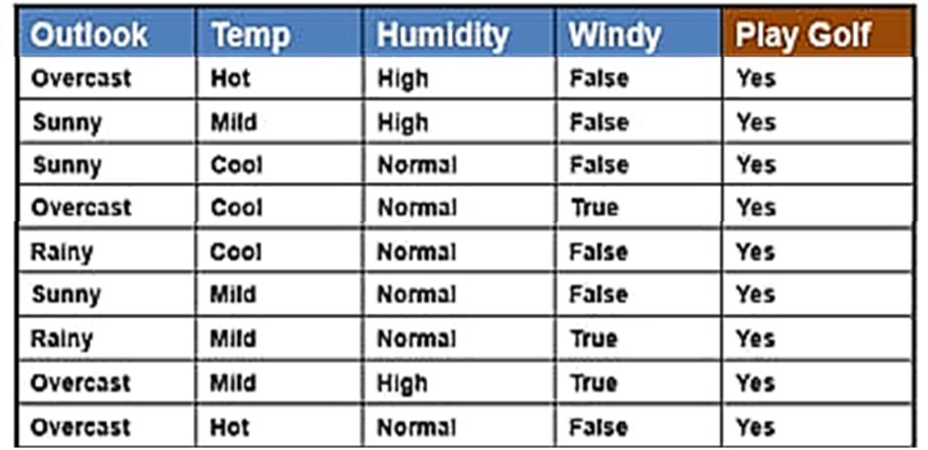
Yes

Slide 22
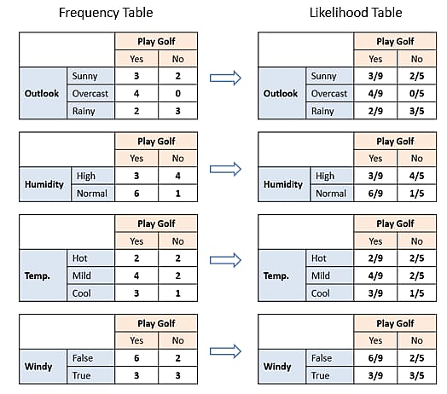
We can see that
P(Yes)=9/14
P(No)=5/14

Slide 23
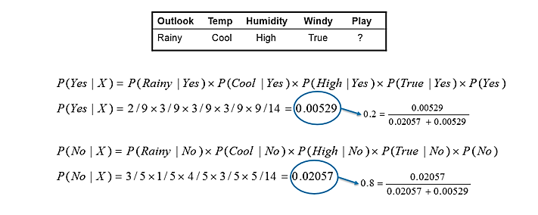
SO it predict -->(Play Golf=No) In this example we have 4 inputs (predictors).

Slide 24


